Slide 1
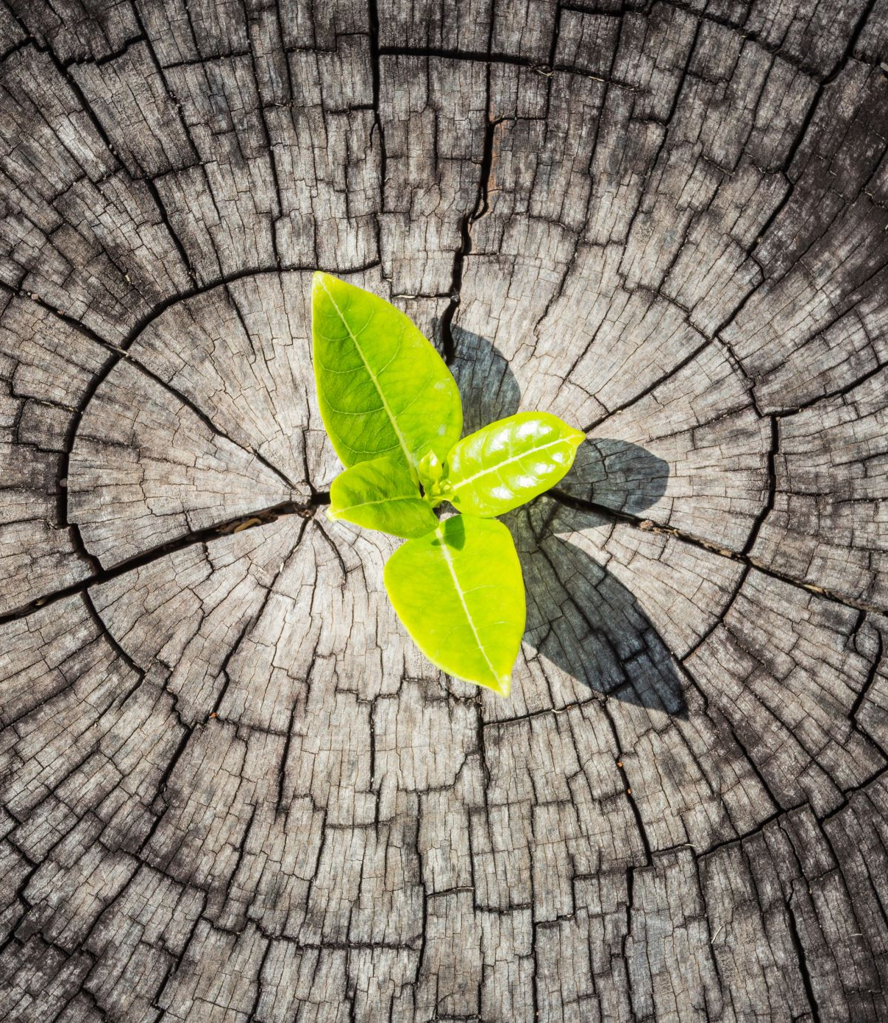

Plantastic Project Update
Tevin, Lisa, Nadia, Marco and Dylan
Notes:
UPDATED

Slide 2
Contents
What is completed?
Upcoming sprint
Notes:
UPDATED

Slide 3
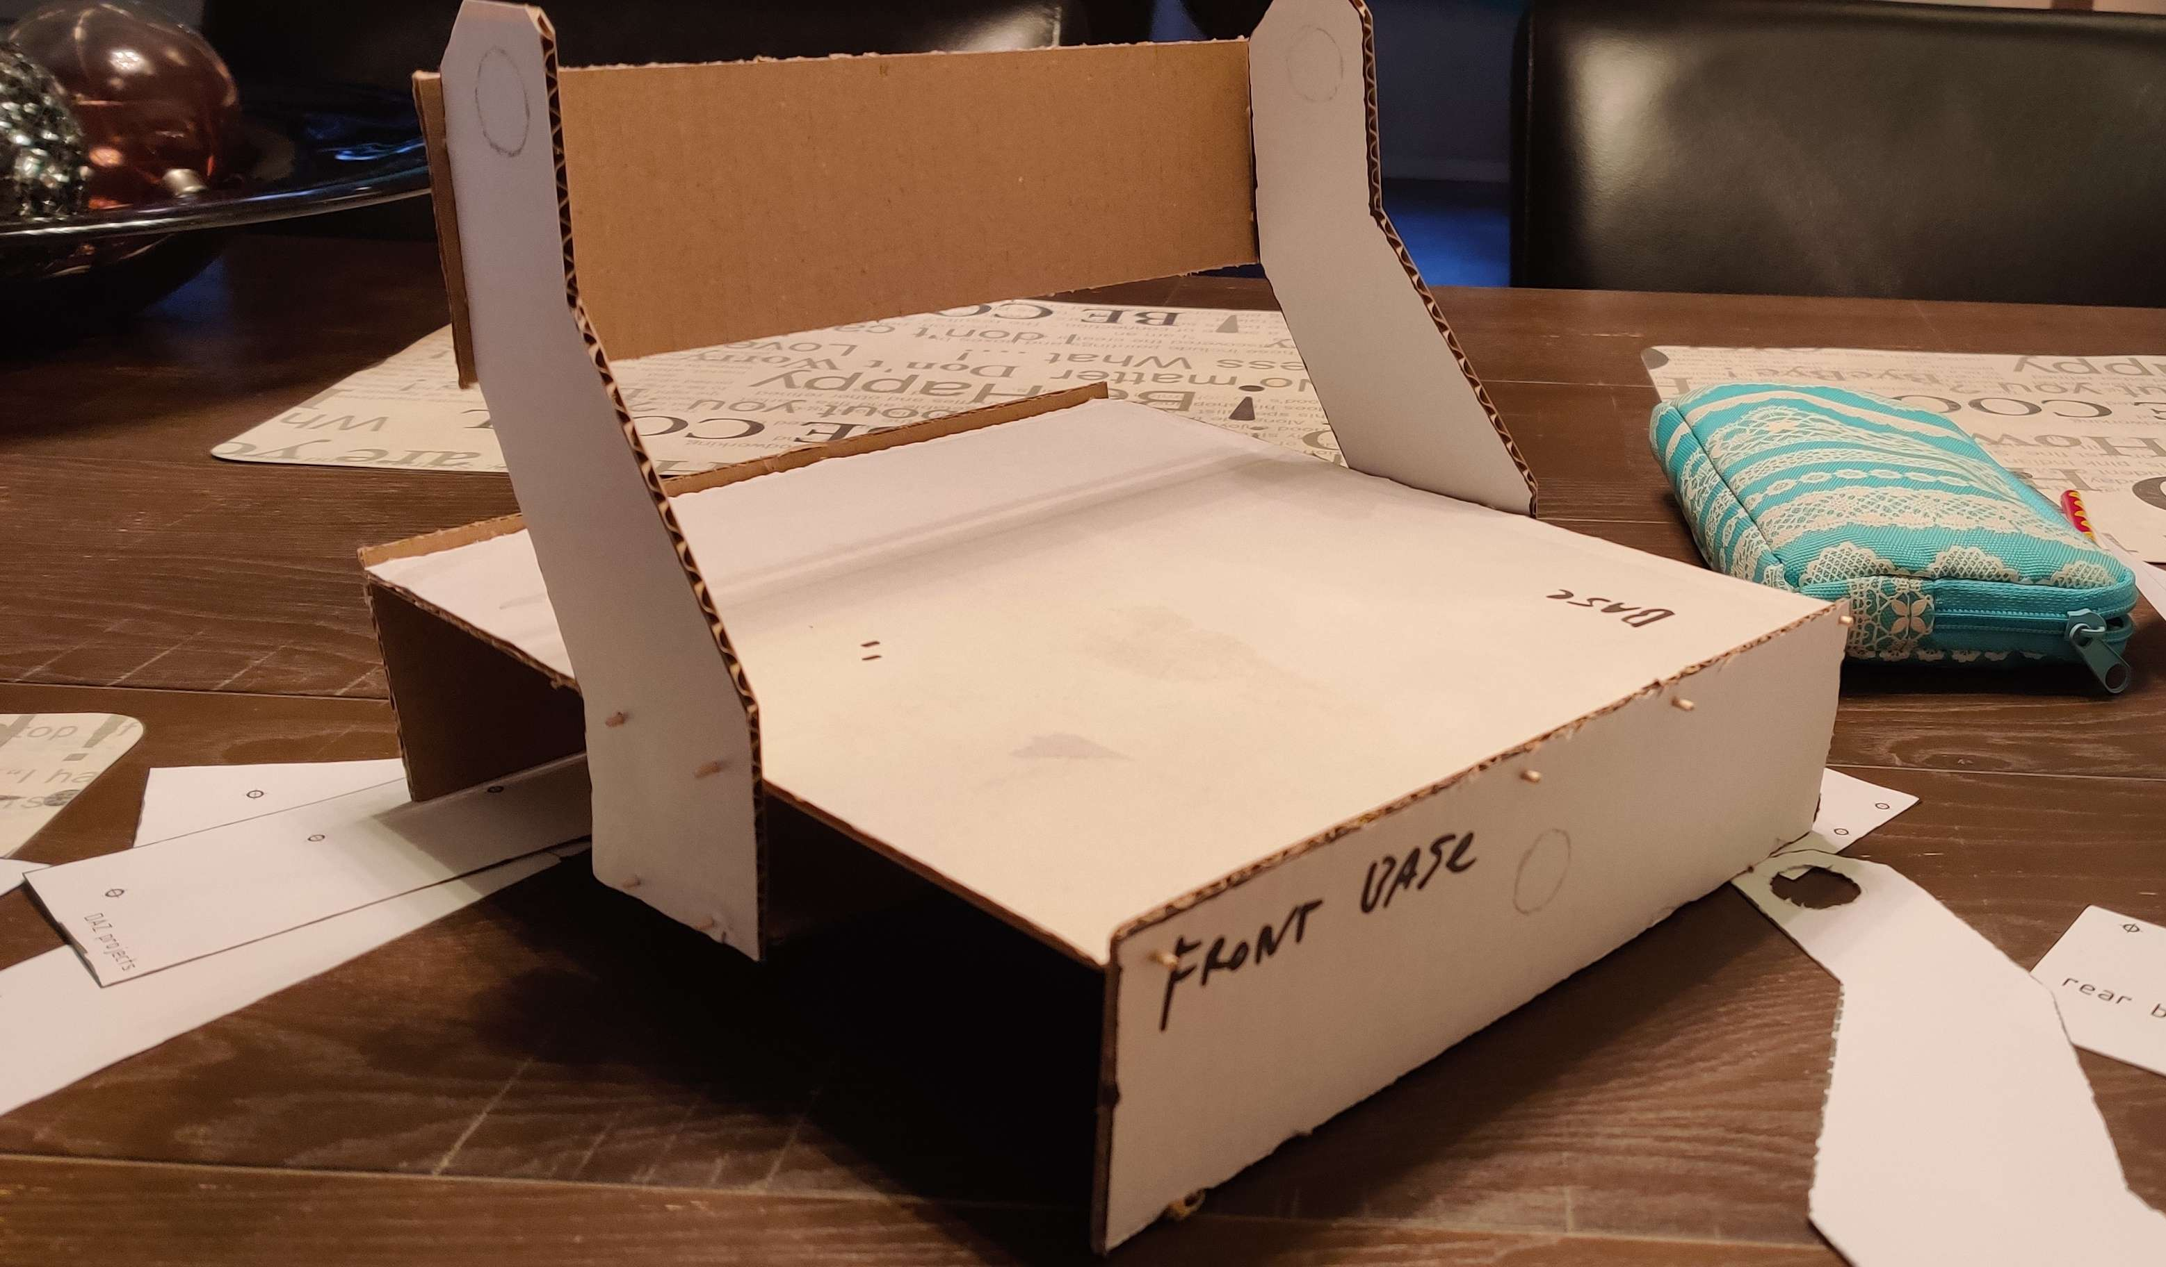
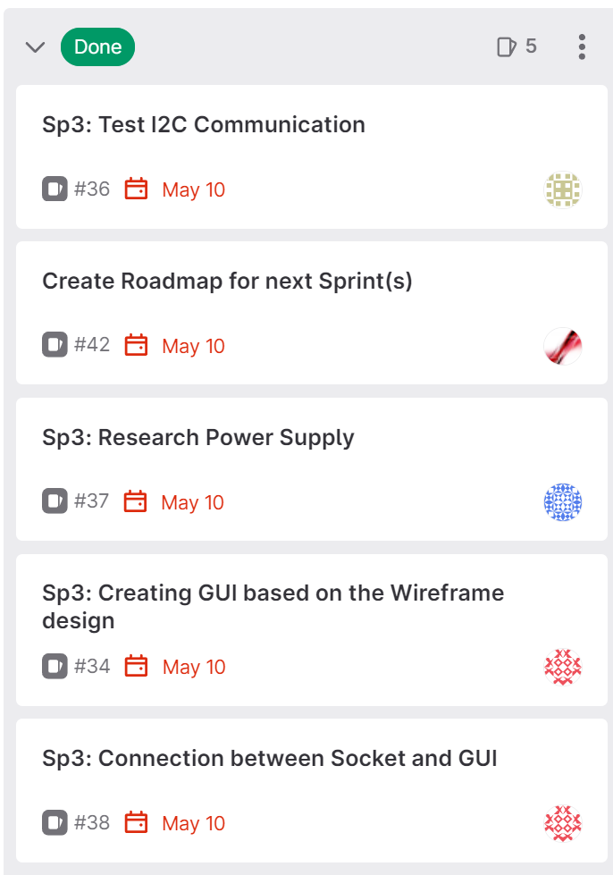
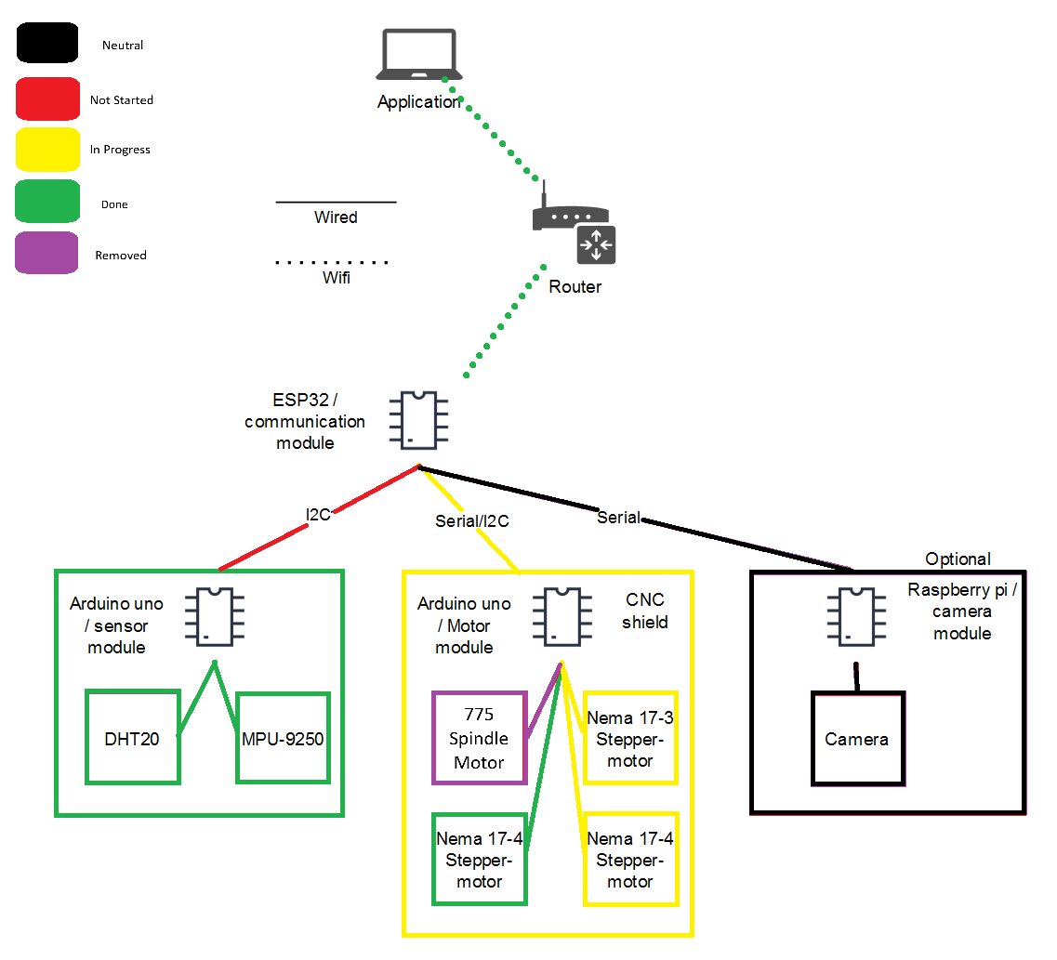
What is completed?
Notes:
(NOT?) UPDATED

Slide 4
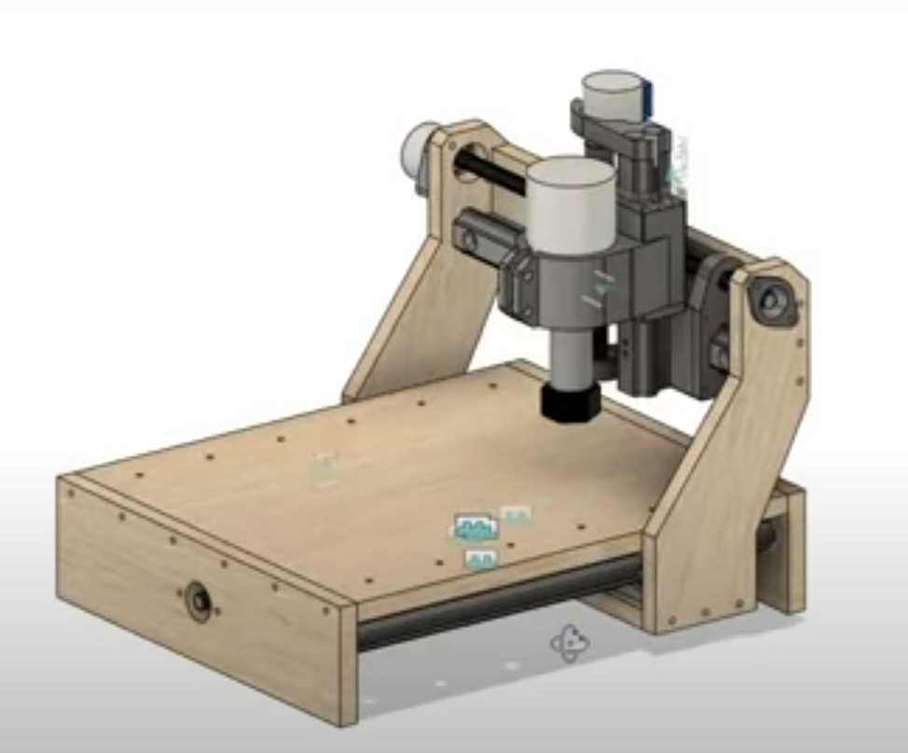
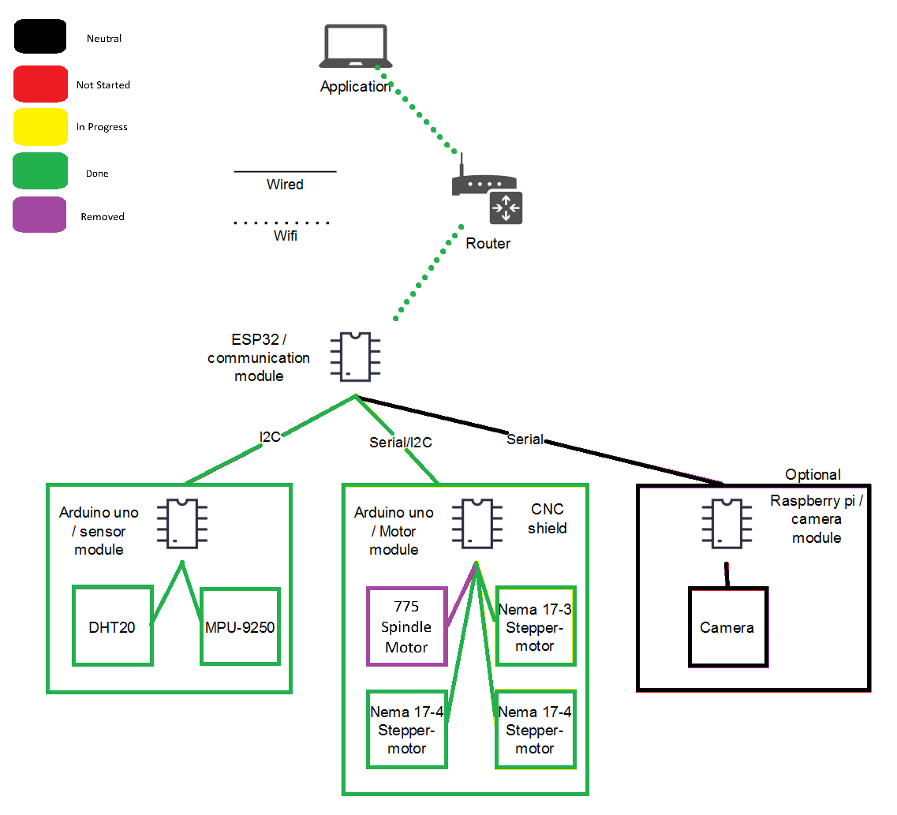
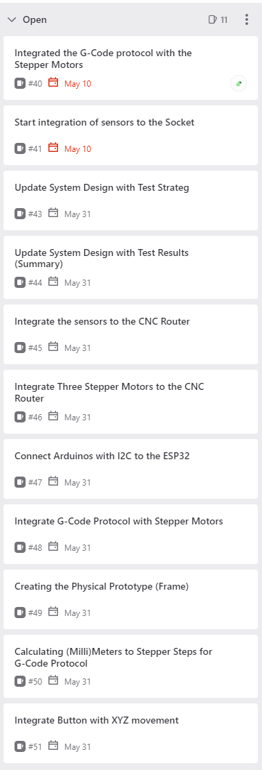
Upcoming sprint
Notes:
NOT UPDATED

Slide 5

Questions?
Notes:
UPDATED

